Slide 1
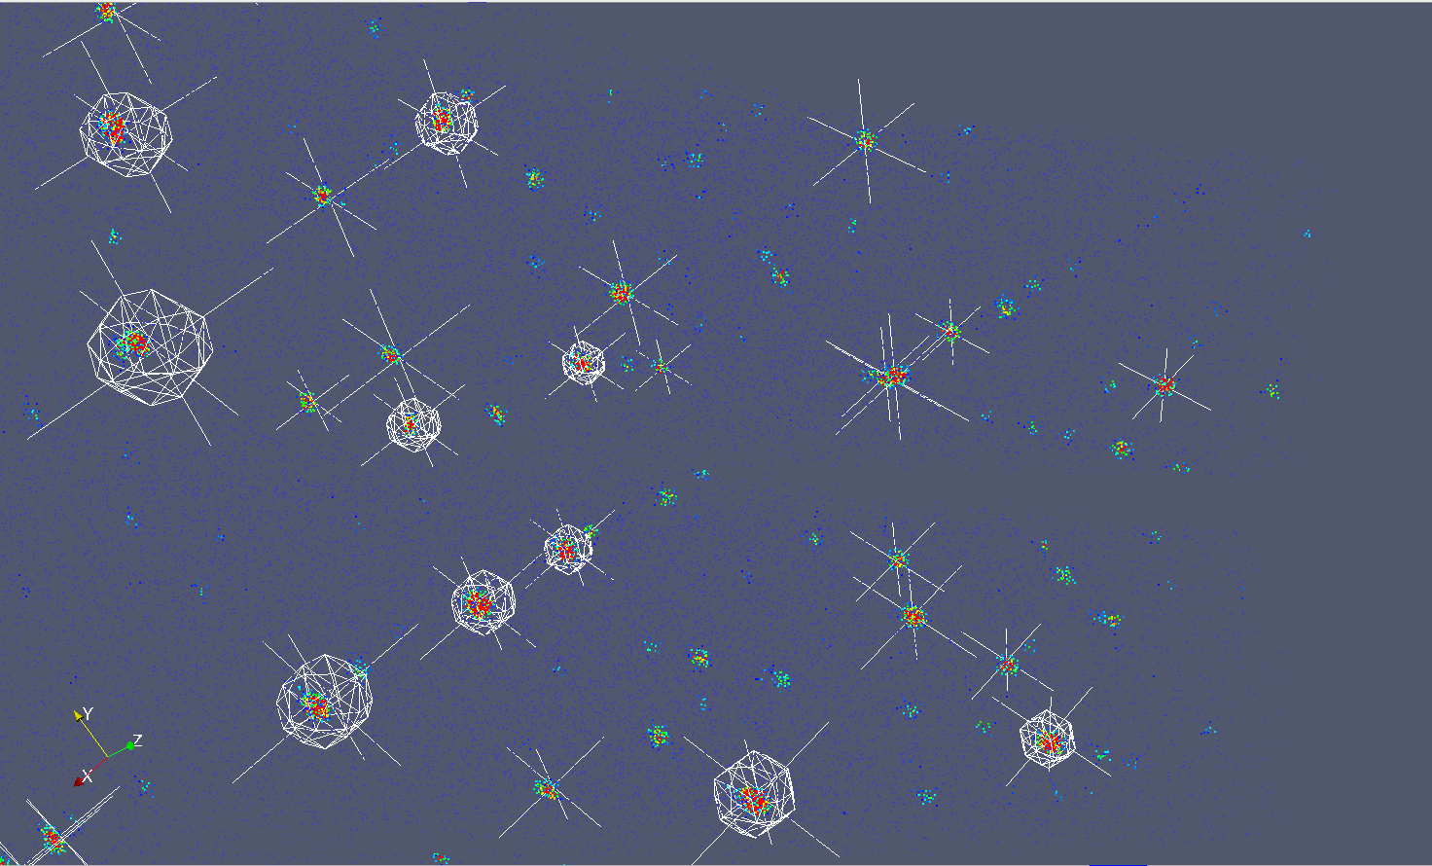
Mantid 2.4
Scientific Steering Committee
Scattering of Triphylite on TOPAZ in reciprocal space.

Slide 2
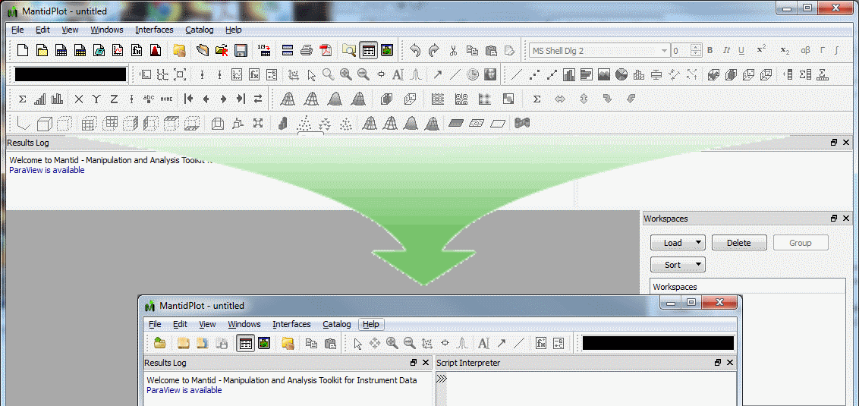
Simplified User Interface

Slide 3
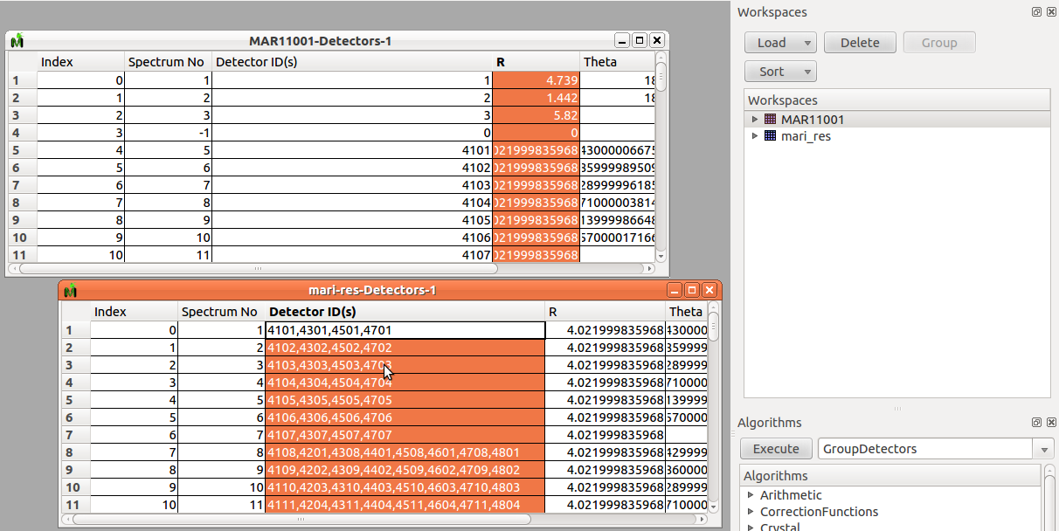
User Interface Grouped Detectors

Slide 4
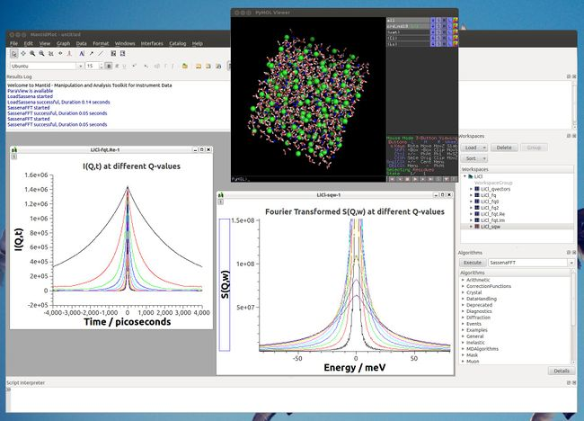
Loading MD Simulation Data

Slide 5
Python
# Set whole numpy array to workspace spectrum
nspectra = 2
xlength = 11
ylength = 10
test_ws = WorkspaceFactory.create("Workspace2D”,nvectors,xlength,ylength)
ws_index = 1
y_values = np.linspace(0,1,xlength)
test_ws.setX(ws_index, y_values)
x_values = np.ones(ylength)
test_ws.setY(ws_index, x_values)
e_values = np.sqrt(values)
test_ws.setE(ws_index, e_values)
# Access goniometer angles
wksp.getRun().getGoniometer().getEulerAngles("yzy")

Slide 6
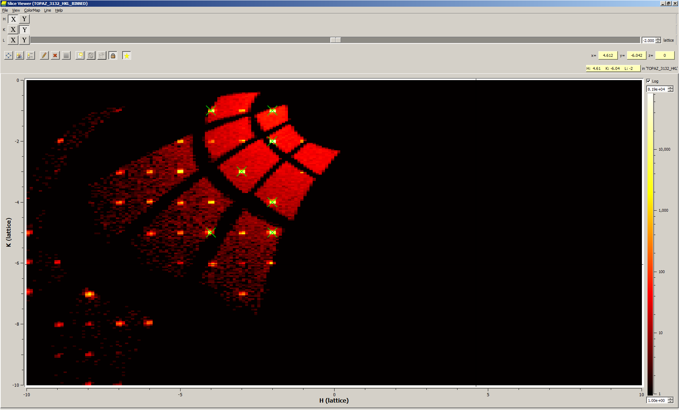
PeaksViewer (Addon to SliceViewer)

Slide 7
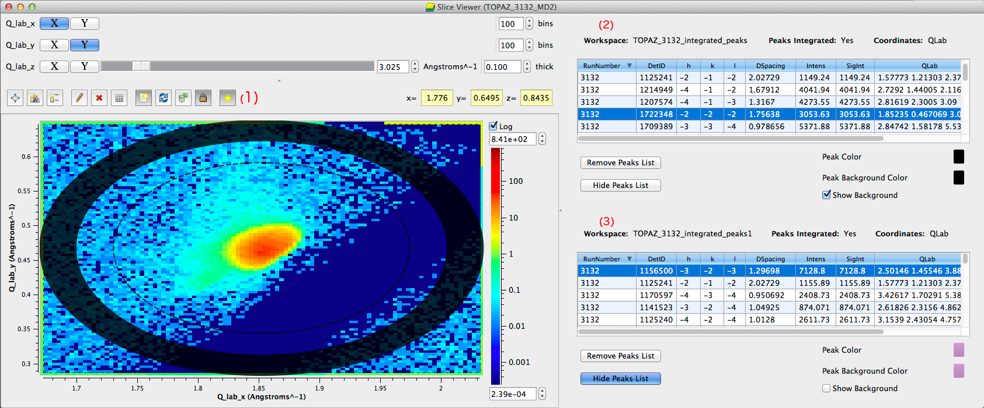
PeaksViewer (Addon to SliceViewer)

Slide 8
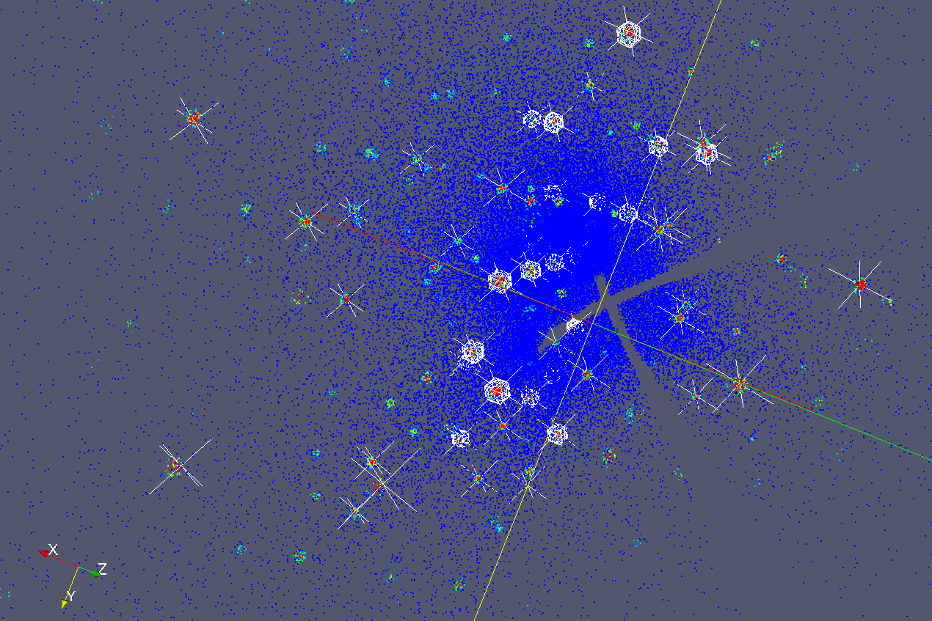
ParaView improvements for viewing Peaks

Slide 9
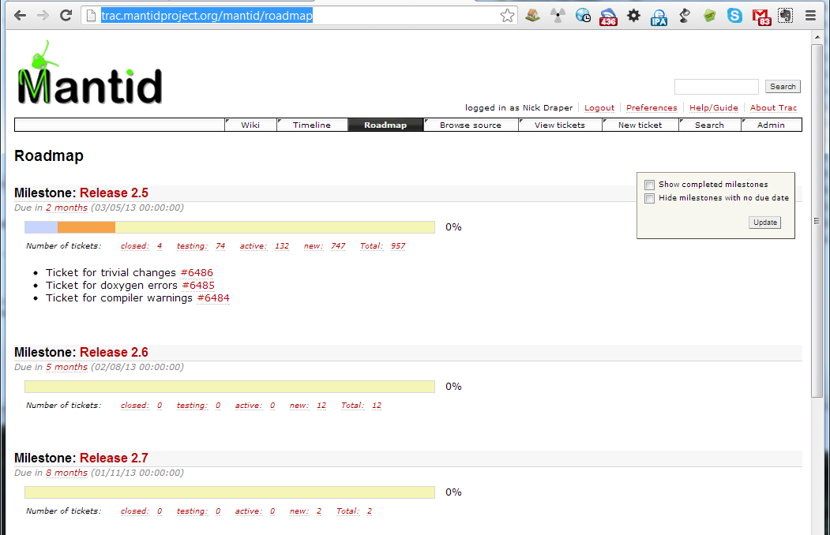
Future Planned Release
Dates have been planned for the rest of the year
Friday 3rd May
Friday 2nd August
Friday 1st November
http://trac.mantidproject.org/mantid/roadmap

Slide 10
Development Areas
Timescale
Short -> Next release
Medium -> Next 12 months
Long -> Longer than a year
Headline items
Other support work continues
Small developments
Bug fixes

Slide 11
Short – Next Release
General
Script Repository
Improved Documentation & Search facilities
Curve Fitting - python curve fits, improvements to sequential, user training
ICAT4 support
Choppers, Guides etc.. in instrument definitions
VATES GUI - axis labelling, non orthogonal axes
Diffraction
More peak integration options & visualization
Direct Inelastic
Remove the need for raw files
Live event data reduction (SNS)- slices, continuous rotation

Slide 12
Medium – Next Year
General
Retire V1 of Python API
Offline help
Redesign of Masking
Reimplementation of GroupWorkspaces
Inst view: Side By side Bank View, Draw on groups, usability improvements
Dropping support for Snow leopard (Mac)
Generic multiple scattering + multi phonon corrections
Generic Sample shape aware absorption corrections
Publication of Processed Data
Live event data reduction (ISIS)

Slide 13
Medium – Next Year
Diffraction
Absorption - Sample Name -> MCNPX cross section data & formula -> cross section
single crystal - Magnetic and Multi grain
LeBail Fitting
Powder Diffraction Reduction GUI
Direct Inelastic
MD Quantification improvements
MD usability - productizing Vates
Indirect Inelastic
Validated support for VESUVIO
Indirect reduction GUI
Indirect Analysis - GUI

Slide 14
Long Term
General
“Intelligent” run control
Sandals and Nimrod support
McStas Intergration
"Publication quality" 1 & 2D visualization - graph in graph, drawing and annotations
MD Quantification integration - GULP etc
Client Server Mantid. Rich GUI with remote compute resource support
MantidCloud - Web interface for common data analyses
Indirect Analysis
Indirect Analysis – Quasilines in Python or C++

